Slide 1

Getting
Started with openNCCC
Notes:
1

Slide 2
openNCCC https://opennccc.nccommunitycolleges.edu/
Meet the Admin Team:
Kathy Davis, Associate Vice President, Distance Learning Technologies
davisk@nccommunitycolleges.edu
Birch Barnes, Director of Library Services
barnesb@nccommunitycolleges.edu
Notes:
This training is being provided by the System Office Distance Learning Technologies team. Kathy Davis, Associate Vice President, Distance Learning Technologies, and Birch Barnes, Director of Library Services, serve as platform administrators.
At the top of this page is the link to openNCCC. I will add it to the chat feature, so that you may follow-along on another screen if you wish, or simply explore and listen while we proceed.
2

Slide 3
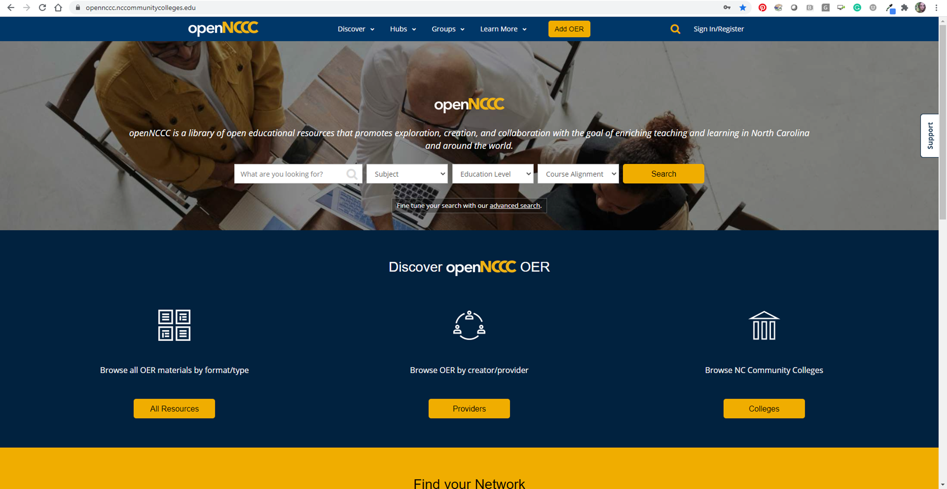
Notes:
To get things started, what you see here is the main landing page for the site. Since you are all members of the North Carolina Community College System, you are able to register and access the full repository.
To give you access to all of the materials on openNCCC, you will need to register. It’s a simple internet form which only takes a few minutes to complete.
3

Slide 4
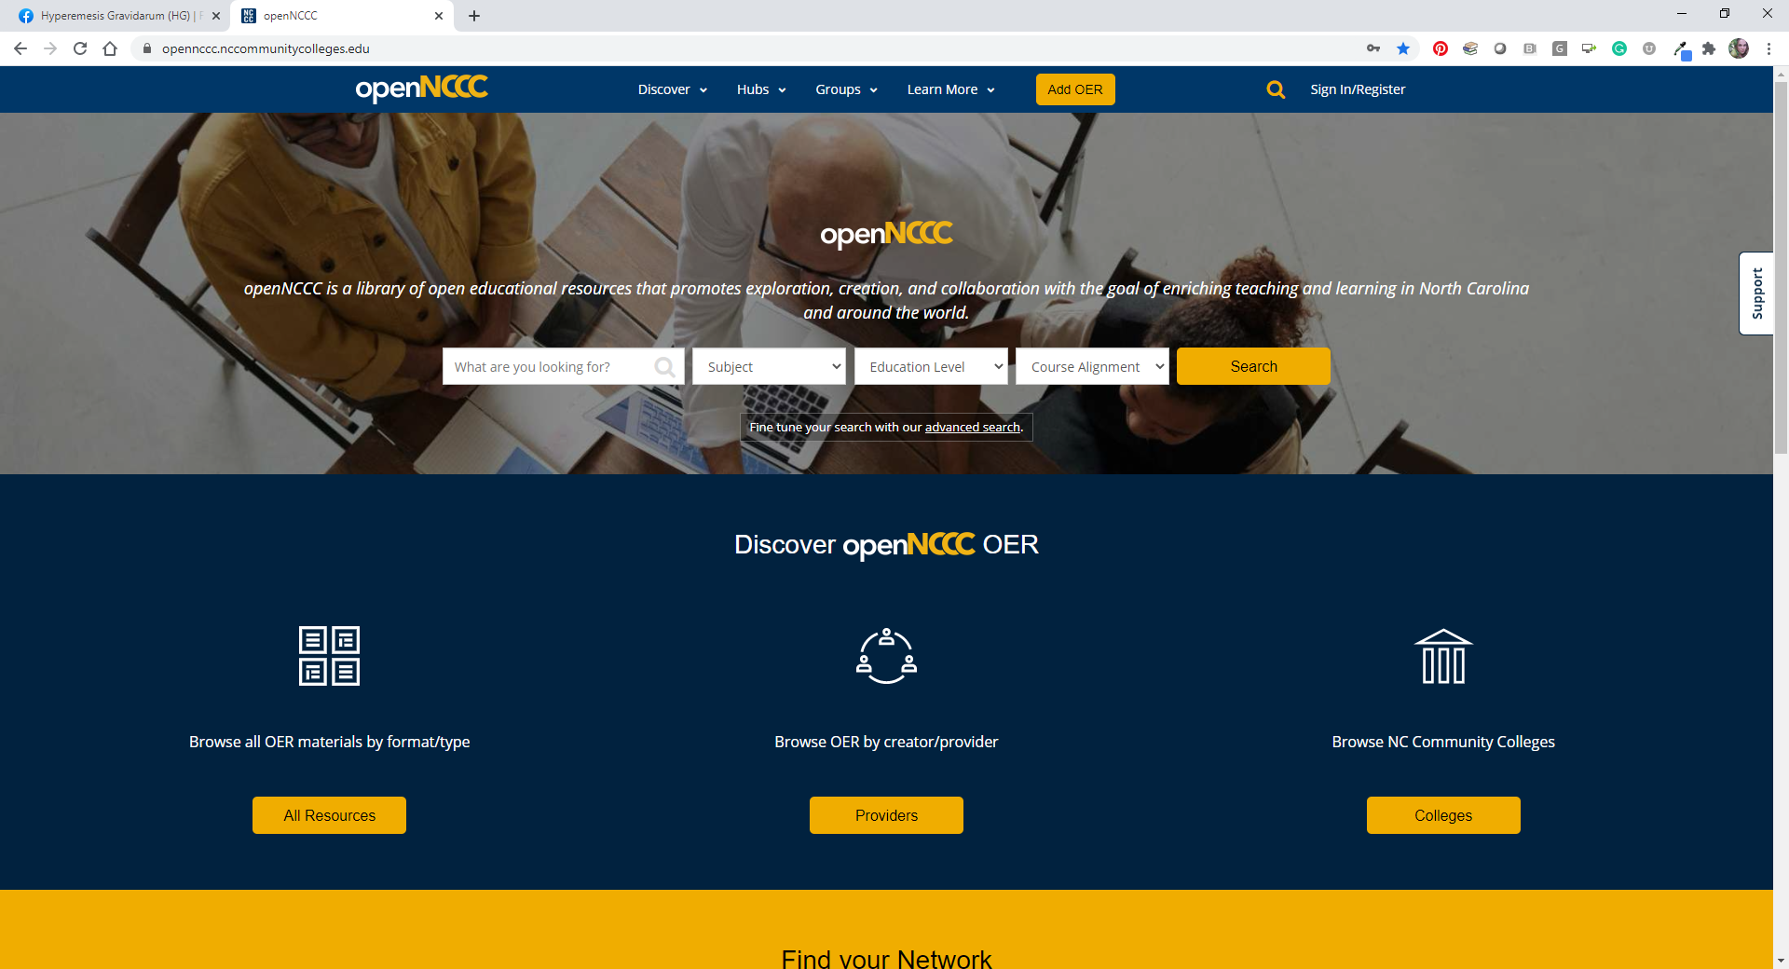
Notes:
Registering is straightforward. Once you’re on the main site, go to the top-right corner and click the “registration” button.
4

Slide 5
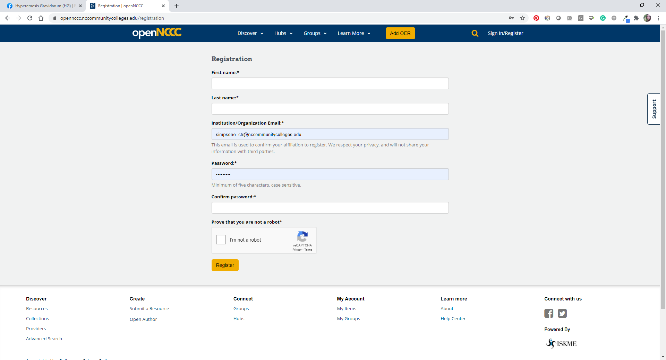
Notes:
Once you’re here, you fill out the form. Make sure you use your community college email. openNCCC is a collection of OERs—open educational resources. These are collections that can be used and shared for educational purposes, but not all of them are publicly distributed. Only faculty and staff of the North Carolina Community College system have access to the full repository.
In another webinar we will go over how to integrate these resources into your Learning Management System to share with your students. Each LMS is a little different, so we are planning on having customized training for each platform.
We are currently in the process of working with each college’s Distance Learning Administrator to complete the integration between openNCCC and your Learning Management System.
5

Slide 6
Notes:
After you have registered, you will shortly have access to the complete database.
Next, we will look at the basics of searching in openNCCC. On the homepage, you have the option of simply typing in some keywords to get started. You also have the option to filter by subject and course alignment. We will discuss course alignment in a few minutes.
6

Slide 7
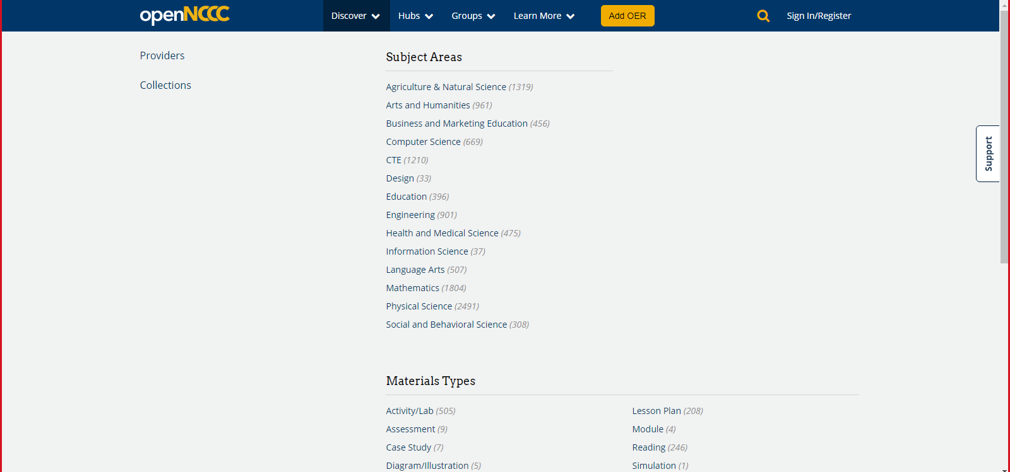
Notes:
That will take us to this page, where you can see the materials grouped by subject area and material type. At the end of each heading, you can see the number of learning objects provided.
7

Slide 8
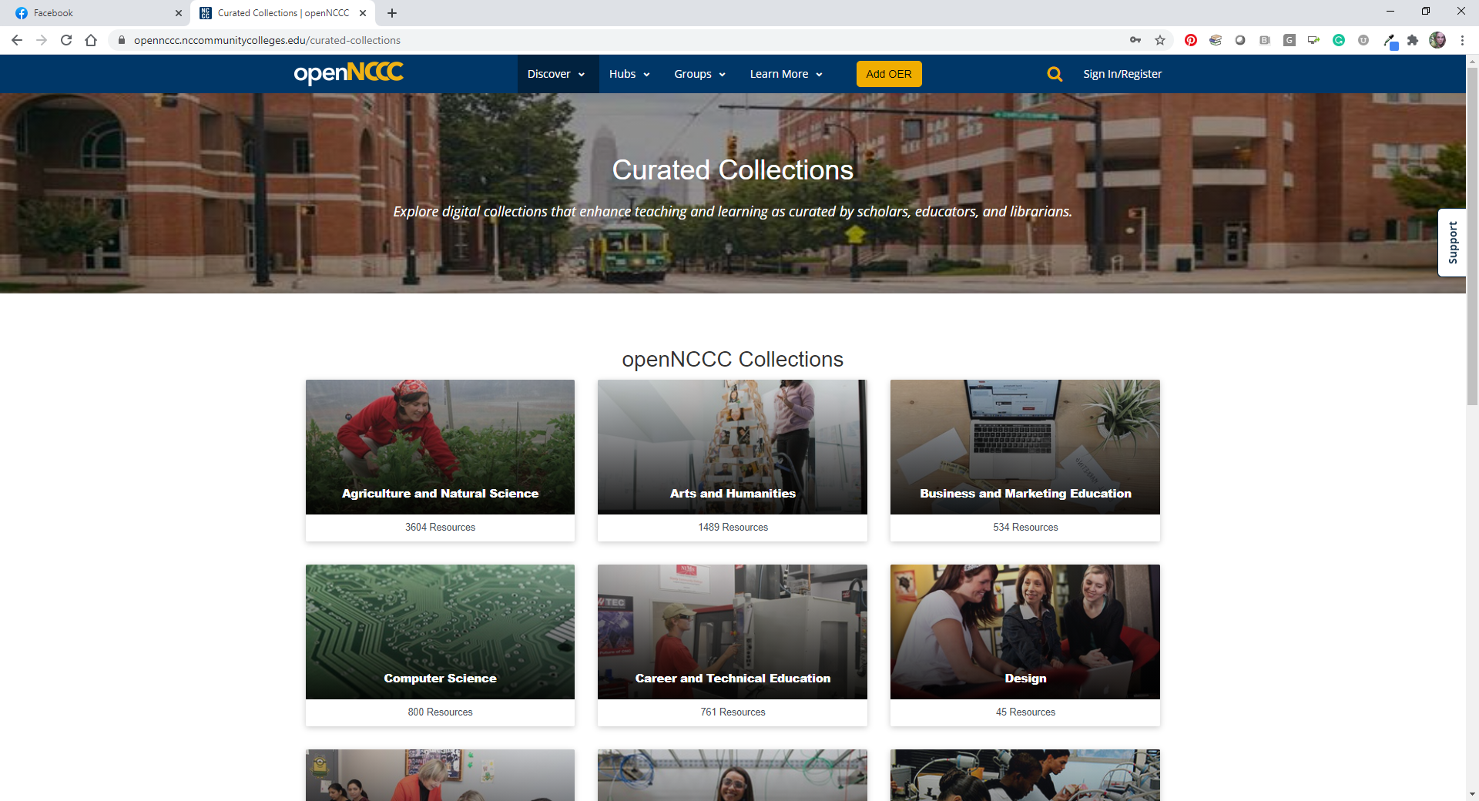
Notes:
Next, click on “Collections”. That will take you to this group of curated collections. We grouped the resources by subject area, to try and make it easier for our users to find useful materials.
8

Slide 9
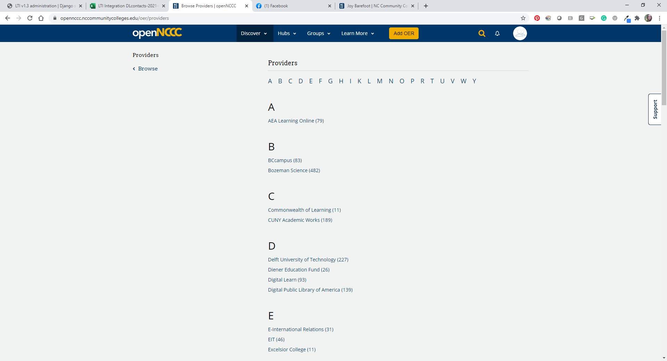

Notes:
Next, go to “providers. This is the list of the various organizations and schools who contributed to the repository.
9

Slide 10
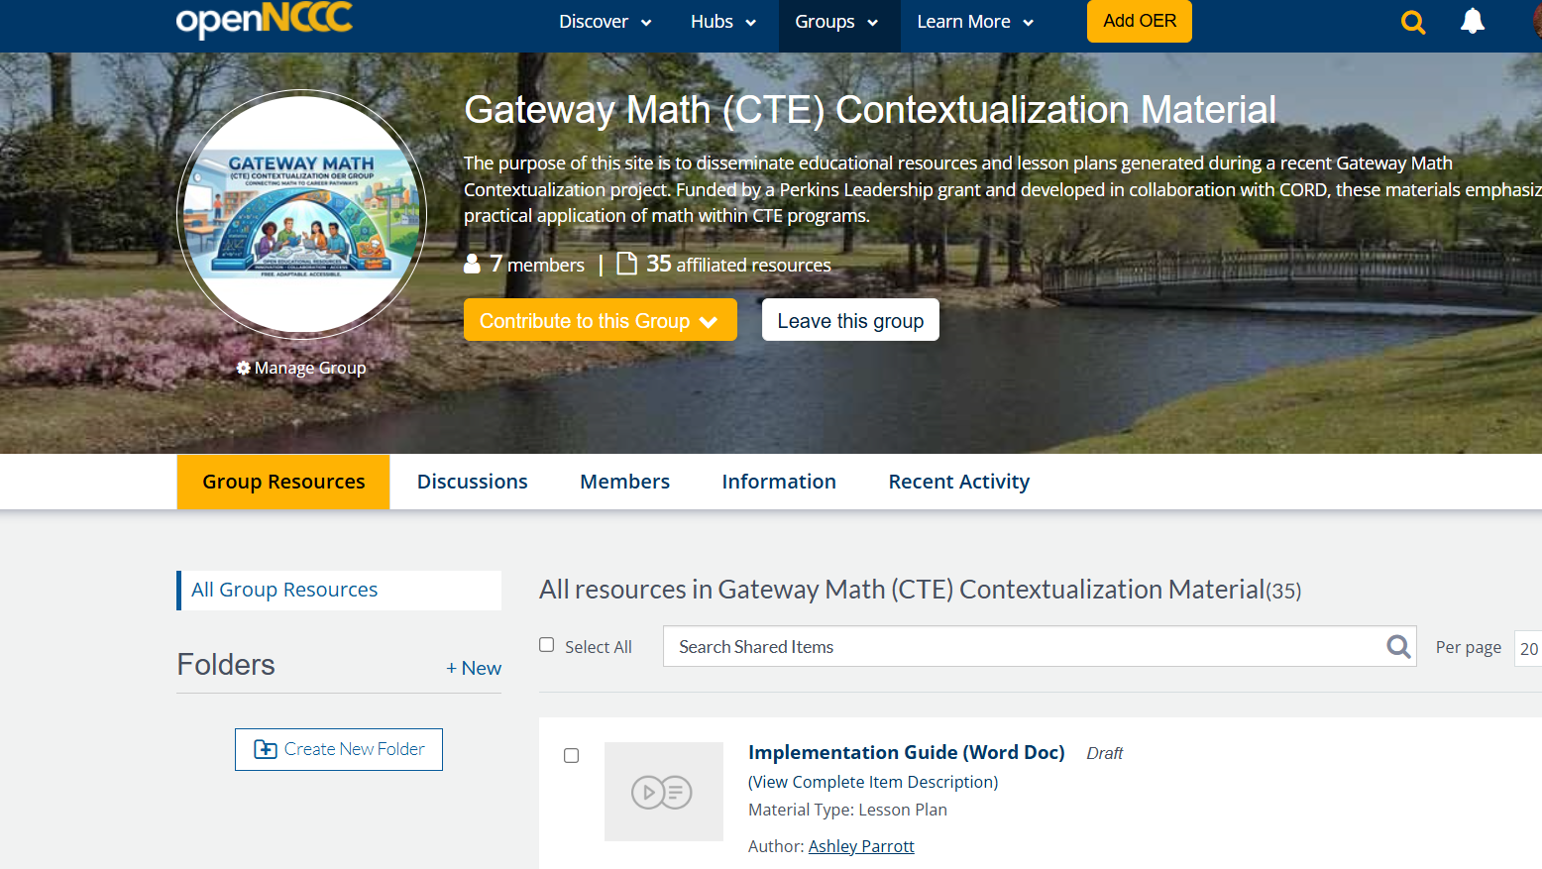
Notes:
Now, we are going to look at the Help Center and the support features of openNCCC
Under “Learn More”, you will find the Help Center.
10

Slide 11
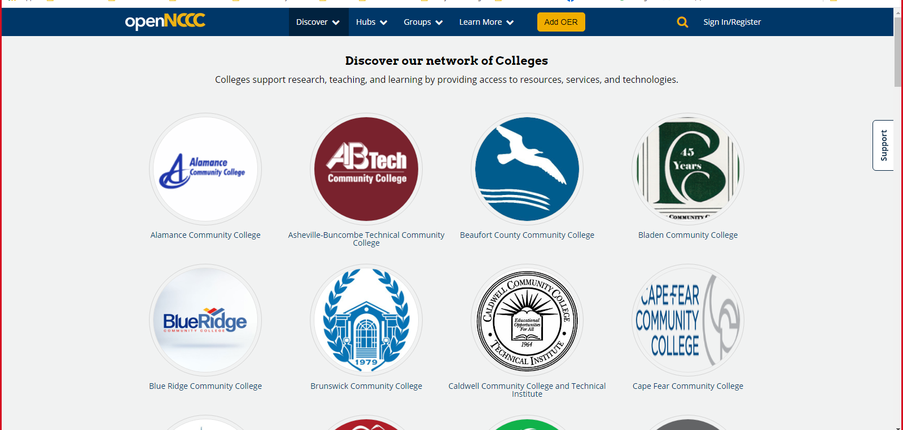
Notes:
If you click on “colleges” under Discover, you will be able to easily filter by the materials shared by individuals at your institution as they are added.
11

Slide 12
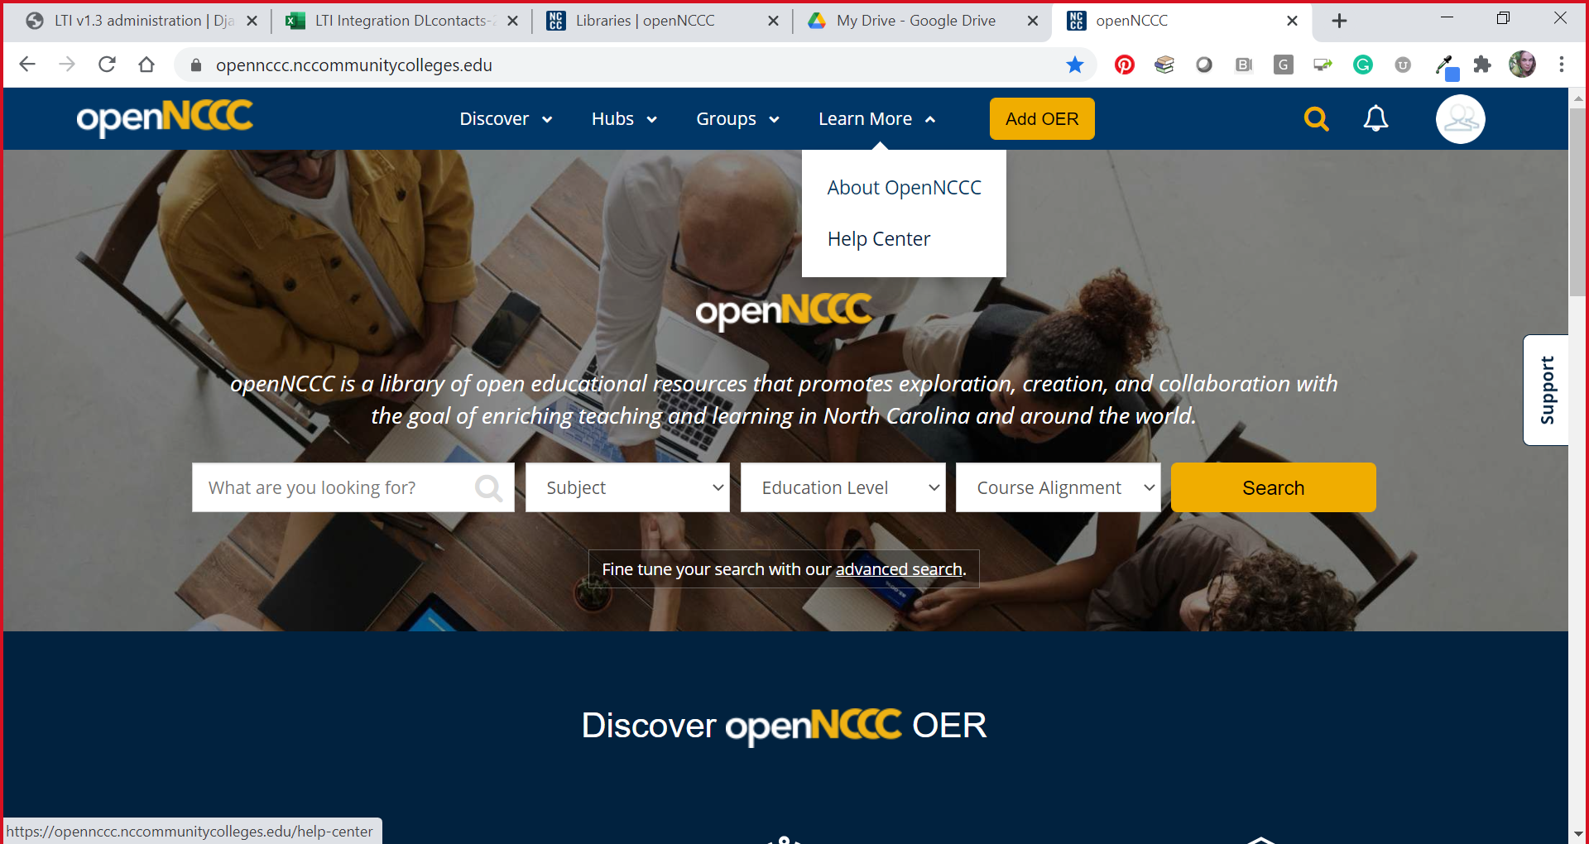
Notes:
Now, we are going to look at the Help Center and the support features of openNCCC
Under “Learn More”, you will find the Help Center.
12

Slide 13
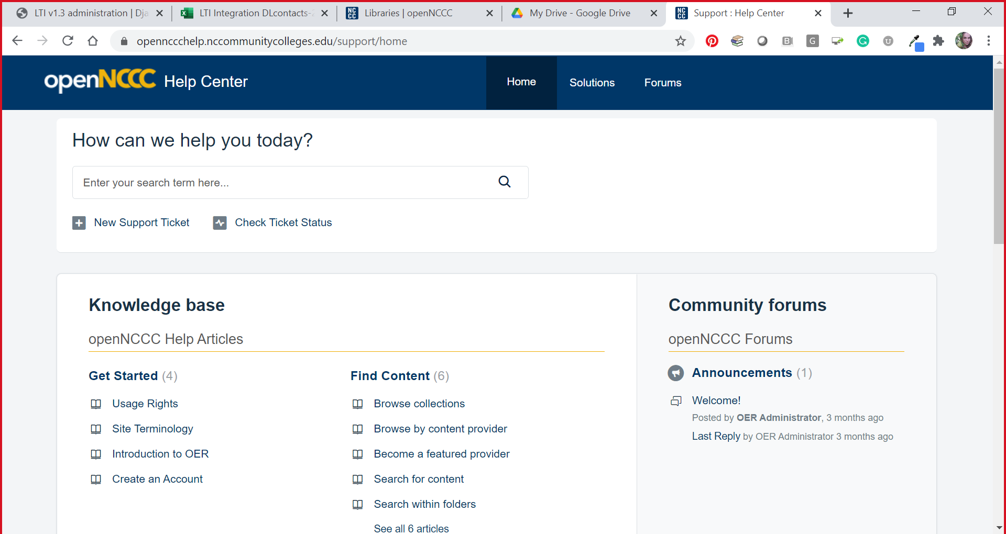
Notes:
The first feature you will see is the search feature, which can help you search the help center.
Under that is the ticketing option.
Knowledge Base. These are written tutorials and documents that address the common concerns with openNCCC. We are continually adding help articles to assist our users, and this will only become more robust as time goes on.
13

Slide 14
General Info:
Tips and Information:
Documents are listed as “Draft” status – this is the correct format for Groups in OpenNCCC.
Send thoughts and collaborative ideas through the ‘discussion’ option if you would like.
Discussions will be sent to all members of the Group.

Slide 15
Let’s look at the platform…
openNCCC
(https://opennccc.nccommunitycolleges.edu/)

Slide 16
Questions?
Contact for assistance:
Kathy Davis
Associate Vice President,
Distance Learning Technologies
davisk@nccommunitycolleges.edu
Birch Barnes
Director of Library Services
barnesb@nccommunitycolleges.edu

