Slide 1
Home Assessment
OTA 130

Slide 2
Home Assessment
Bridges the gap between in-patient care and life at home after discharge
Often a multi-disciplinary assessment with OT and PT
Client willingness to modify the home and financial ability must be considered prior to the assessment
Client and family members living in the home should be present during the assessment

Slide 3
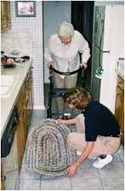
Who Needs Home Assessment?
Client’s who are active and/or are at greater risk for falling
Client’s who are going home alone or with limited supervision with changes in their physical or cognitive function
Client's who are going home in a w/c or other device and accessibility needs to be assessed
Anyone who is at risk for safety or accessibility issues in their home

Slide 4
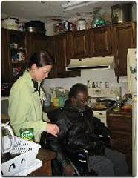
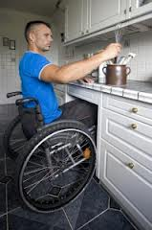
Assessing Accessibility
Begin by explaining the purpose and procedure
Bring the patient's mobility device through the house to ensure it fits in key areas
Survey the general arrangement of the room with furniture and arrangement

Slide 5
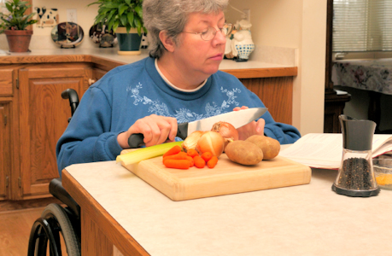
Assessing Accessibility
Client should demonstrate transfers, mobility and basic self-care and home management techniques to ensure safety and accessibility.
Observe for safety, mobility and performance and limitations imposed by the environment

Slide 6
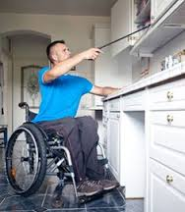
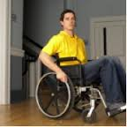
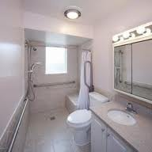
Home Modifications for Accessibility or Safety
Things to consider:
Expense
Prognosis of recovery
Short-term disability
Long term disability
Progressive illness
Convenience
Patient and family perspective

Slide 7
Observations
YouTube "Carol's Home Modification“
YouTube "Senior Fall Prevention In-Home Assessment“

