Slide 1
Radiation Sensitivity
Created By Rebecca Berger

Slide 2
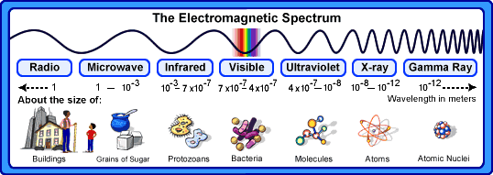
What is Radiation?
Radiation is the transmission of energy in the form of waves or particles through space or through a medium.
This includes:
  electromagnetic radiation: such as radio waves, microwaves, visible light, x-rays, and gamma radiation found on the Electromagnetic Spectrum
  particle radiation: such as alpha radiation and beta radiation
  acoustic radiation: such as ultrasound and sound
Radiation is often categorized as either ionizing or non-ionizing depending on the energy of the radiated particles.
  Ionizing has the capability of producing biological and chemical changes in the body
    Such as X-ray, Cat Scan, Nuclear Medicine, and Radiation Therapy
  Non-ionizing does not cause any know biological or chemical changes
    Such as Ultrasound, MRI

Slide 3
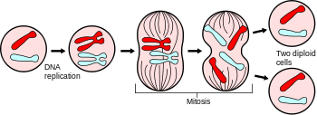
The Law of Bergonie and Tribondeau
The Law of Bergonie and Tribondeau was a very important discovery in 1906.
The Law states “radiosensitivity is a function of the metabolic state of the cell being irradiated”
In diagnostic imaging, this law serves to remind us that the fetus is considerably more sensitive to radiation exposure
Important points to remember about cellular replication and radiosensitivity:
1- Stem or immature cells are more radiosensitive than mature cells
2- Younger tissues and organs are more radiosensitive than older tissues and cells
3- The higher the metabolic cell activity, the more sensitive to radiation
4- The greater proliferation and growth for tissues, the more sensitive to radiation.

Slide 4
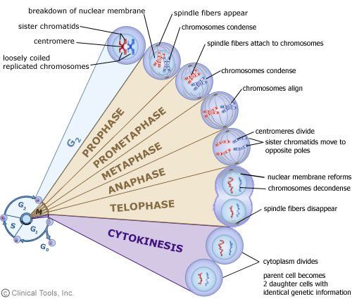
Mitosis and Cellular Replication Review
Based on the Law of B & G:
Cells are most sensitive to radiation interactions during Mitosis (M) and early in the DNA synthesis phase (S)
Cells are least sensitive to radiation interactions in G₂ and late S phase.
Cytologists can determine chromosomal damages during Metaphase.

Slide 5
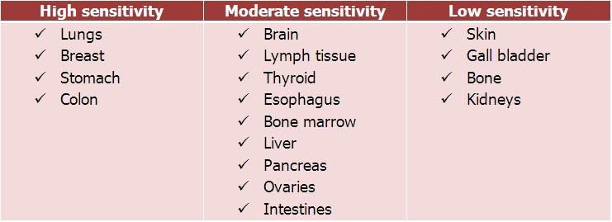
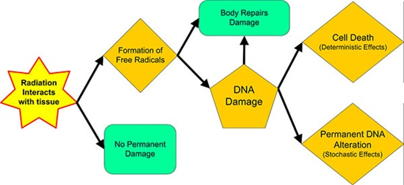
Radiosensitivity Cell type
Low
  Nerve cells
  Muscle cells
Intermediate
  Osteoblasts
  Endothelial cells
  Fibroblasts
  Spermatids
High
  Spermatogonia
  Lymphocytes
  Stem cells
  intestinal mucosa cells
  Erythroblasts

Slide 6
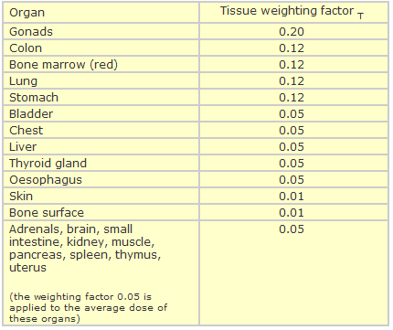
Effective Dose
To understand how different tissues are more radiosensitive, simple calculations are needed to be able to compare.
We know that some organs are more Sensitive to radiation than others based on their cellular replication process and frequency:
Please use this chart below to help you:
We will use rads as our unit to quantify radiation dose absorbed into the tissues
Patient was exposed to the following:
5 rads to gonads
5 rads to lungs
5 rads to skin
To determine the dose: take the Tissue Weighing Factor and multiple it by the dose for each tissues. See below:
Calculate:
5 rads x .20 = 1.0
+ 5 rads x .12 = .6
+ 5 rads x .01 = .05
Total of 1.65 rads
Based on these calculations, which of these organs are the most sensitive to radiation?
Compared to the skin, how do the lungs compare in sensitivity?

Slide 7
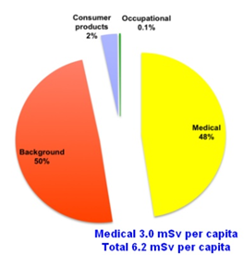
Radiation Exposure to the Public
  Ionizing radiation from environmental sources is called
  NATURAL BACKGROUND RADIATION
  Examples:
  Radon – 68% of natural background
  Terrestrial: radioactive materials from the earth
  Cosmic: comes from the sun (solar) and beyond the solar system (galactic)
  Internal: radionuclides, radioactive atoms that come from body tissue.
ARTIFICIAL/MAN-MADE RADIATION
Industrial ( Nuclear power), medical x-rays, air travel, atmosphere fallout from weapons etc.
Medical Procedures acct for ~ 3 msv per yr ! ( out of 3.09 msv of total Man-made type) (* rest is .13 of consumer, occupational, and industrial)
3.11 msv from Background + 3.09 man-made = 6.2 msv total
3.11 msv from background radiation out of 6.2 msv total

Slide 8
Background Equivalent Radiation Time (BERT) based on background estimate of ~ 3 msv
Chest radiograph | (.06 msv) | 1.5 wk ( 10 days) to receive same dose in nature * 1.5 wks was based on a fraction comparison to the 3 mSv for the entire year. This something the patient can understand.
Thoracic Spine | (.5 msv) | 6 mo. to receive the same dose in nature
Lumbar Spine | (3 msv) | 1 yr. to receive the same dose in nature * For comparison, this exam would equal one year’s worth of radiation exposure in the natural environment
Upper Gi series | (4.5 msv) | 1.5 yrs to receive the same dose in nature
BE***** | (6 msv) | 2 yrs. To receive the same dose in nature

Slide 9

BERT – Simple way of explaining to the patient that a chest exam is around 10 days worth of natural radiation.
Students should not refer to the rest of the exams, as it may be alarming to them.

